Slide 1





PERFORMANCE ANALYTICS KIMIA FARMA BUSINESS YEAR (2020-2023)
Presented by
FADHIL APTANA SADJIANA
Kimia Farma - Big Data Analytics

Slide 2



Final Assignment Link
1. Folder Results Folder Link: https://drive.google.com/drive/folders/1bayIlqfnavlK3ZiX8eqQpTe7sBOg7YSC?usp=sharing
2. Link to Video Presentation of Work Results: https://drive.google.com/drive/folders/1nbhvt2c-Ac6yOEFmgOetc2yw3jrCHku1?usp=sharing
3. Github Link for Work Results: https://github.com/sadjiana/Kimia-Farma-Big-Data-Analytics-March-2024-Period-/blob/main/README.md

Slide 3




Hello, let me introduce myself, my name is Fadhil Aptana Sadjiana, I am usually called Fadhil. I come from Andalas University, majoring in economics. I am a fresh graduate. I have several experiences, including, so far I have participated in internships 3 times, the first at the Indonesian Ministry of Education and Culture in the field of Human Resources, then the Indonesian Ministry of Finance in the field of Data Analyst, and now at PT Kimia Farma Tbk, as Big Data Analytics. I also joined one of Andalas University's projects, namely the Andalas University Book Project, and I also served as a teaching assistant while I was studying.
Padang, West Sumatra
fadhilaptanasadjiana@gmail.com
Fadhil Aptana Sadjiana

Slide 4

About Company
PT Kimia Farma Tbk is a subsidiary of Bio Farma which does business in the pharmaceutical sector. To support its business activities, by the end of 2020, this company had 12 factories, 1,278 pharmacies, 451 health clinics, 75 clinical laboratories, 10 opticians and 3 beauty clinics spread throughout Indonesia. The company also has 18 retail outlets in Saudi Arabia. Pharmaceutical preparations and medicinal raw materials made by this company have also been exported to India, Malaysia, Maldives, Kenya, Yemen, Hong Kong and the Philippines.

Slide 5
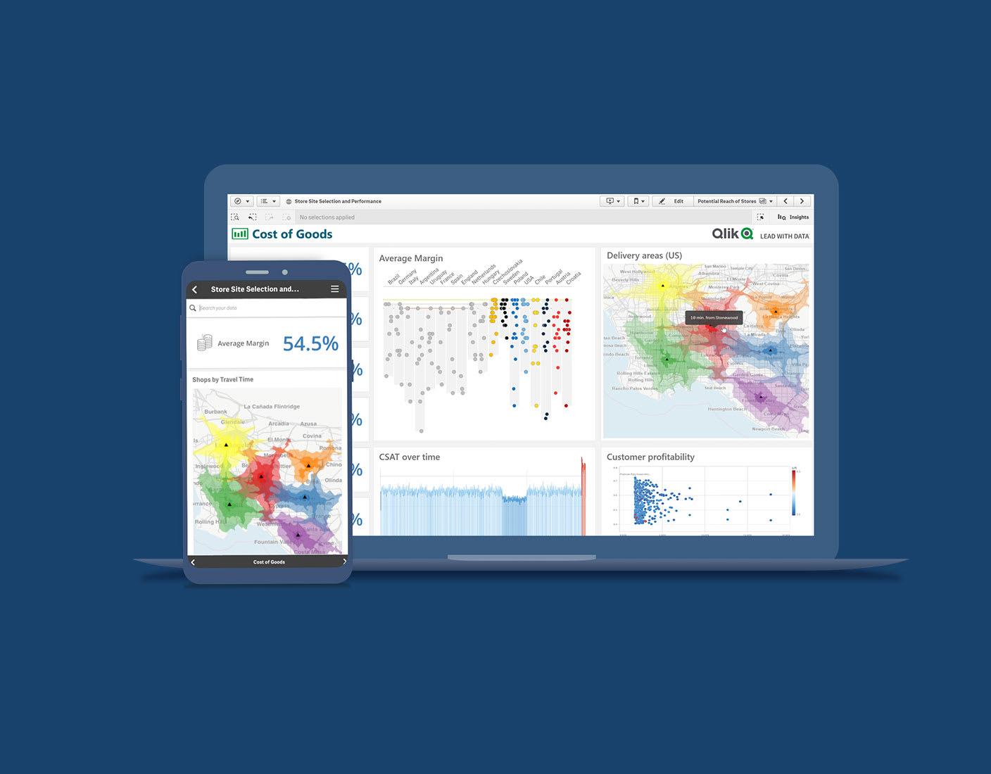
Project Portofolio
The Project Based Internship Program in collaboration with Rakamin Academy and Kimia Farma Big Data Analytics is a self-development and career acceleration program intended to deepen the position of Big Data Analytics in the Kimia Farma company. This program provides access to basic learning in the form of Article Reviews (reading materials) and Company Coaching Videos (video learning) to introduce the competencies and skills that Big Data Analytics must have in companies. The final task that will be created in this program is to create a Kimia Farma Business Performance Analytics Dashboard for 2020-2023.
Project Explanation Video Here!
https://drive.google.com/drive/folders/1nbhvt2c-Ac6yOEFmgOetc2yw3jrCHku1?usp=sharing

Slide 6
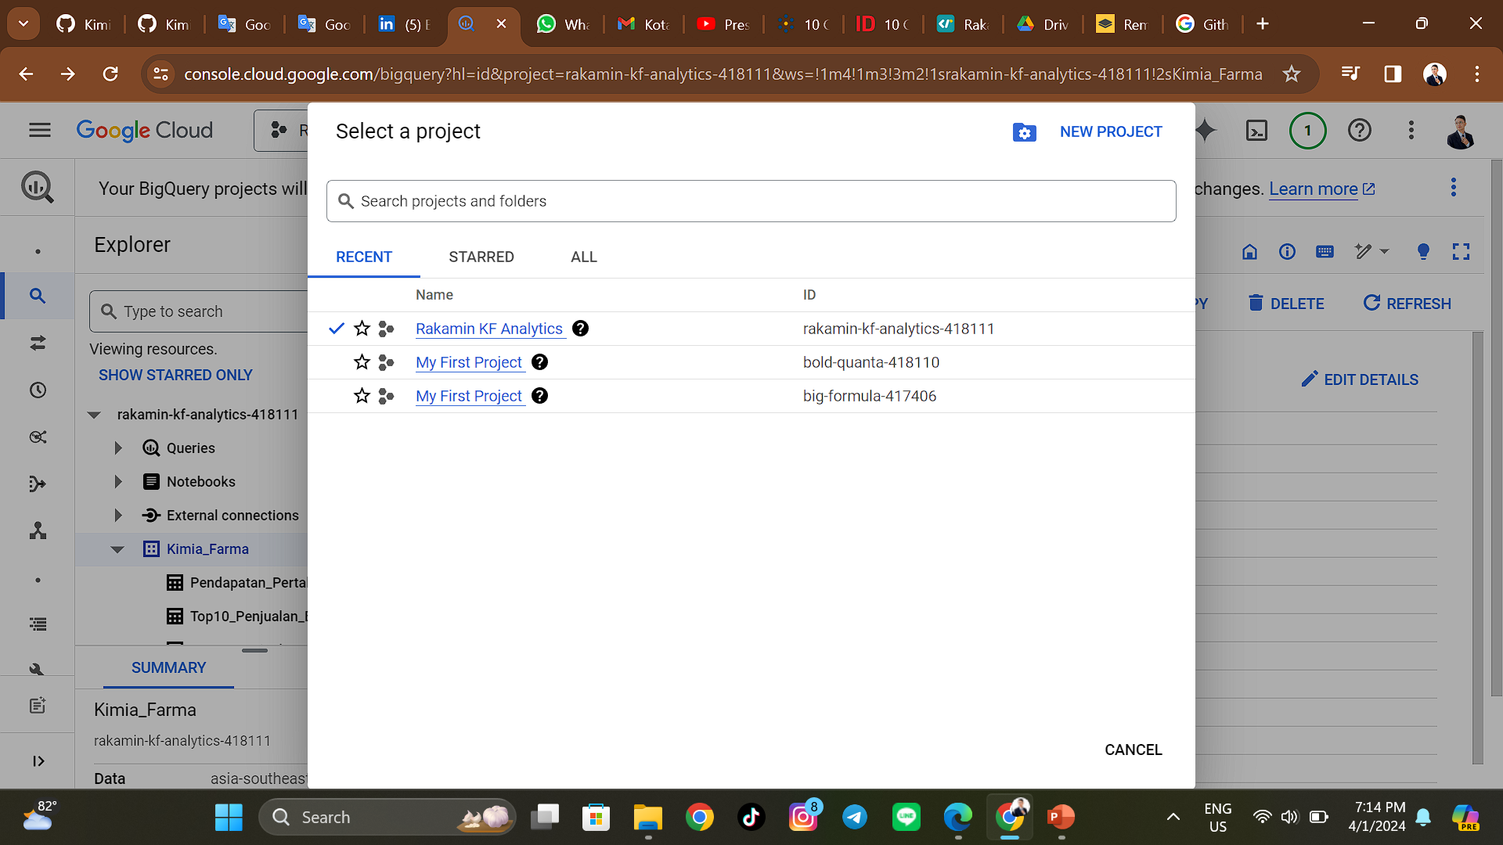
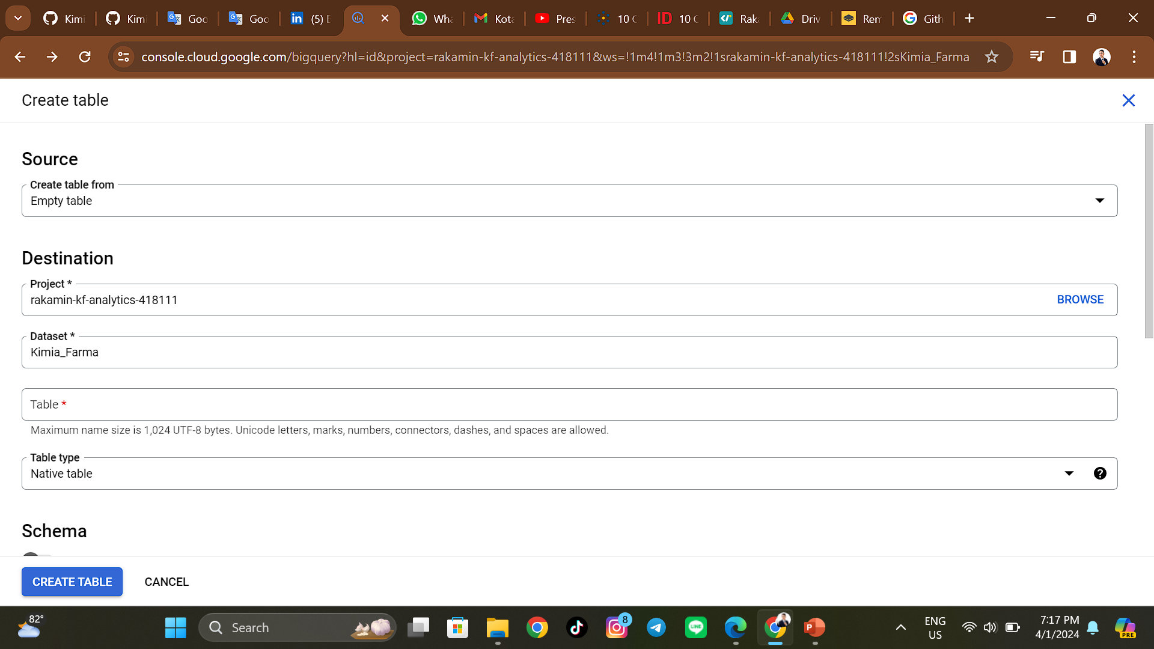
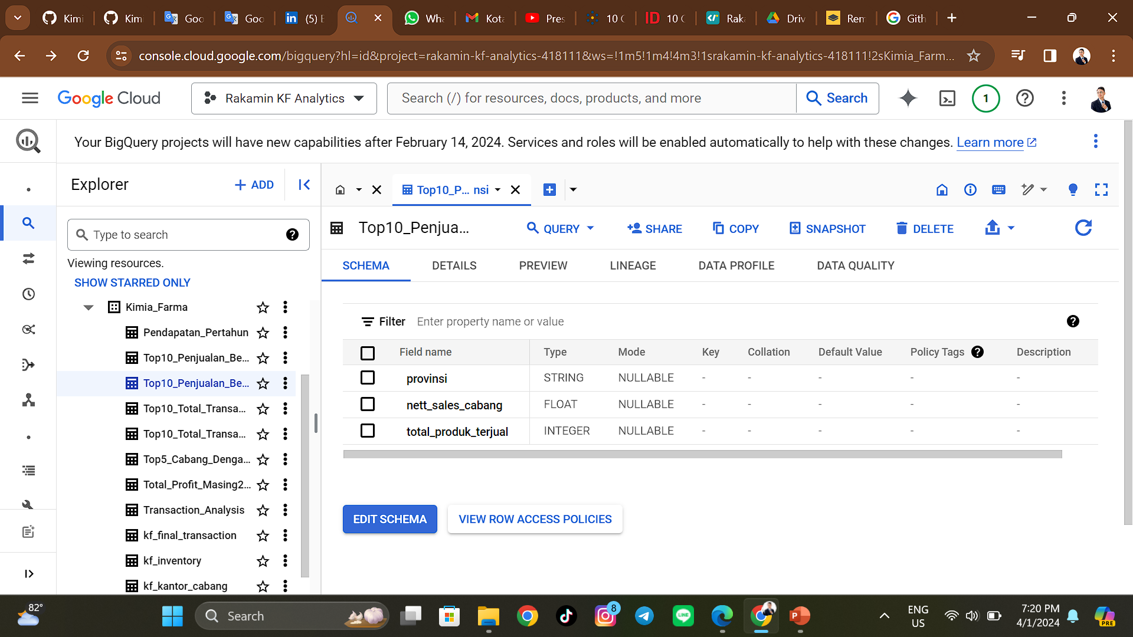
Create a new project in Google Cloud Platform >>>
1. Importing Dataset to BigQuery
Preparation Before Data Processing
There are several steps I took before starting data processing. The first step I have to do is prepare the raw data into structured data so that the data is ready to be processed. The steps taken when preparing the data are:
A. Download the data set provided by Kimia Farma, the data is as follows:
kf_final_transaction.csv
kf_inventory.csv
kf_kantor_cabang.csv
kf_product.csv
B. Create a new project in Google Cloud Platform - BigQuery with the existing name conditions
C. Import a dataset from data provided by Kimia Farma, create a new name for the table uploaded to Google Cloud Platform - BigQuery, and provide auto-detect on the schema to create a new schema display according to the data that was previously imported into the dataset
Import a dataset from data provided by Kimia Farma >>>
Table display in the Kimia_Farma dataset >>>

Slide 7
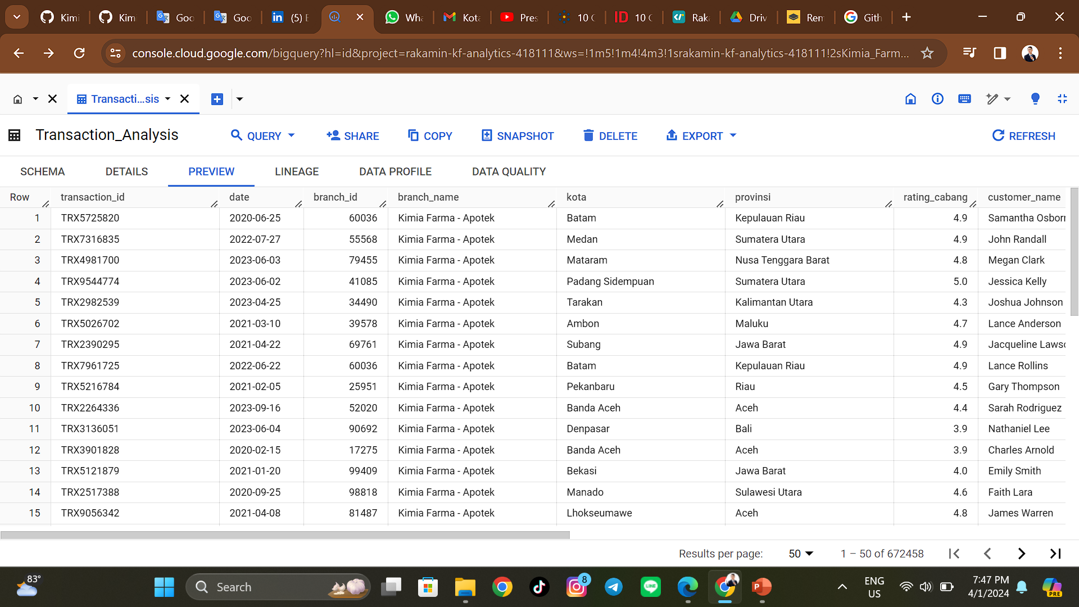
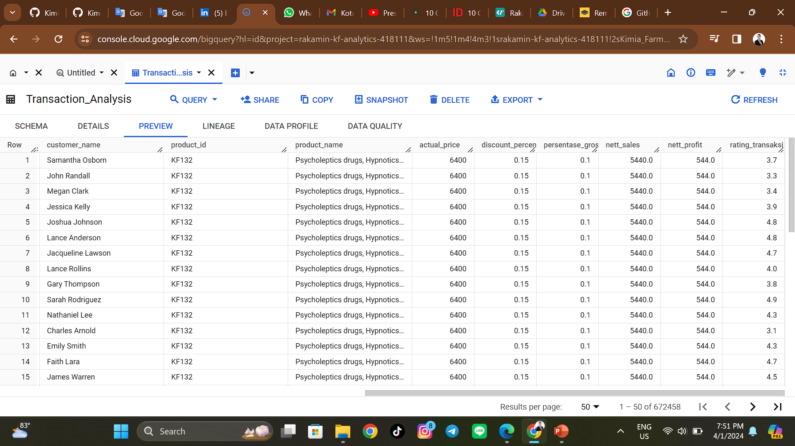
2. Table Analysis
Analysis Transaction Table >>>
The Analysis Transaction Table is used to view the overall data needed to perform data analysis with SQL, both in rows and columns. This Analysis Transaction Table is used as a benchmark and data source for creating tasks per each instruction given as material for creating a dashboard.

Slide 8
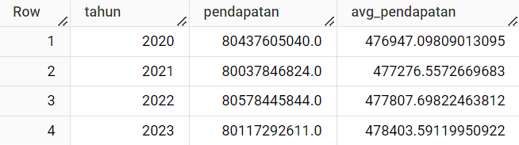
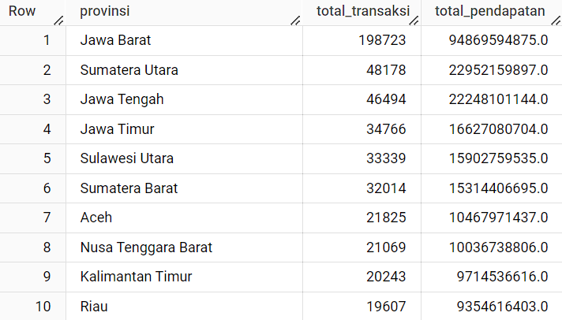
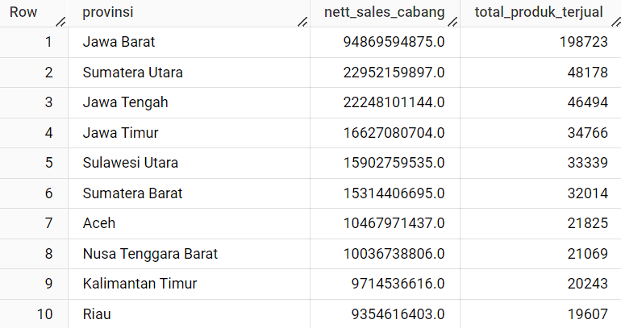
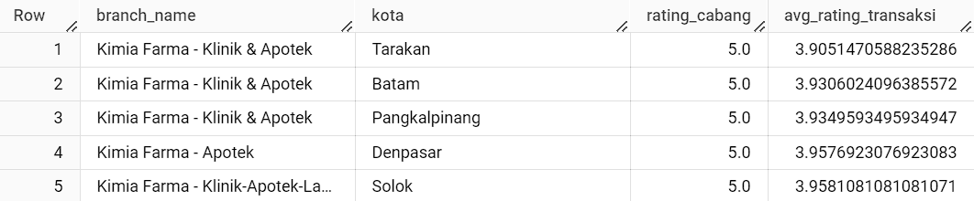
KIMIA FARMA COMPANY INCOME (YoY)
TOP 10 TOTAL PROVINCE BRANCH TRANSACTIONS
TOP 10 PROVINCE BRANCH NET SALES
TOP 5 BRANCHES WITH THE HIGHEST RATING, BUT THE LOWEST TRANSACTION RATING

Slide 9
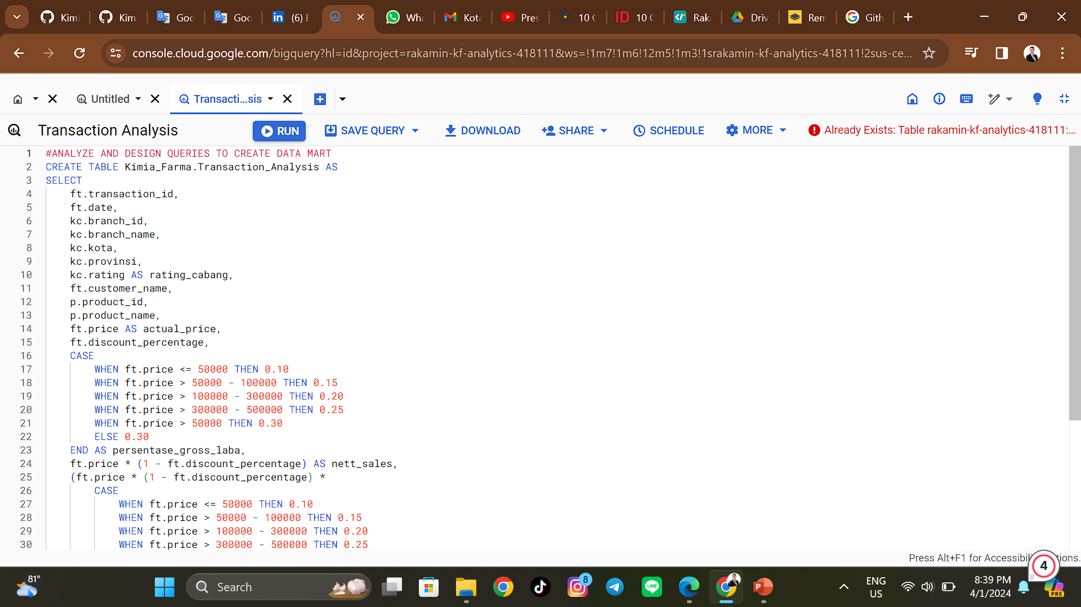
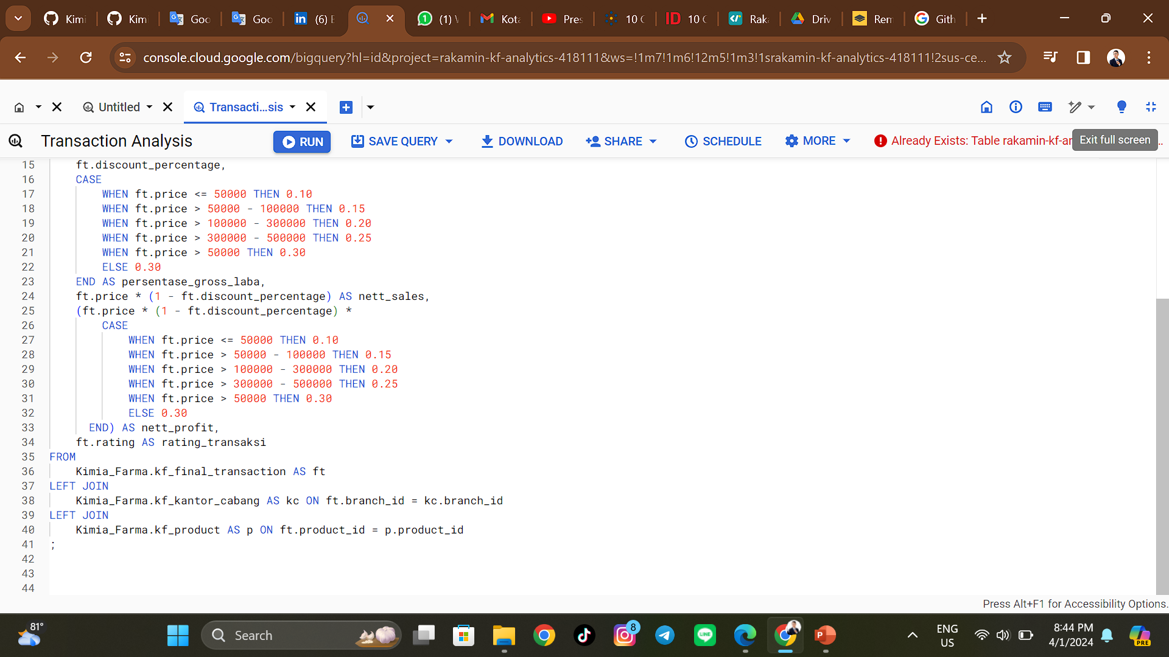
3. BigQuery Syntax
Analysis Transaction Queries >>>
Besides BigQuery Syntax, it is BigQuery Syntax which is used to create transaction tables. BigQuery Syntax besides using SQL to process or analyze data. I use Table CRUD (CREATE TABLE) to create a table. Then to retrieve multiple columns from a particular table I use a SELECT query. I also used the SQL LEFT JOIN operation to return all rows from the left table and match on the left table. To process the gross profit percentage, I use SQL CASE. In this way, the data that I process becomes structured according to the instructions given.

Slide 10
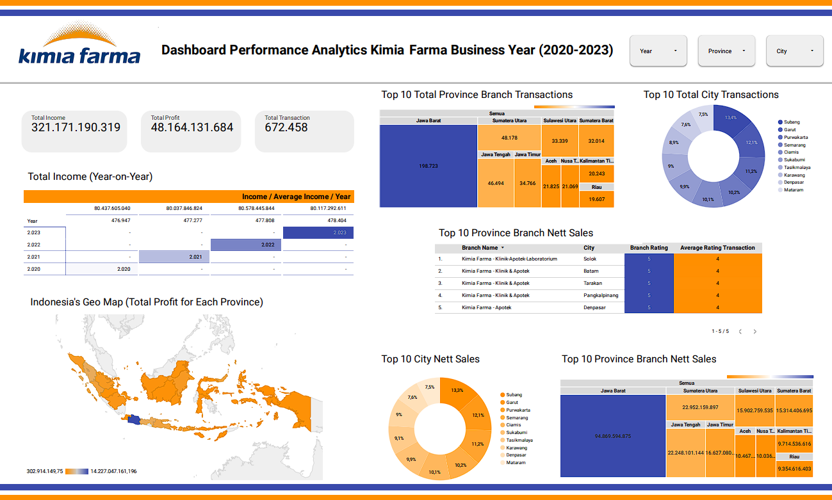
4. Dashboard Performance Analytics
From the dashboard on the side, you can see that several important indicators can be used as parameters in interpreting the data. We can analyze and review in terms of income, profits, and total transactions on sales of medicinal products in each particular table. If we look at annual income, total income experiences increases and decreases or insignificant fluctuations. However, we can see that in 2021, annual income has decreased. This was caused by the Covid-19 pandemic that hit at that time. So there was a decrease in income from the previous year. then in 2022 and 2023, income will return to its normal fluctuation trend again.
Next, we looked at the provincial and city branches. If we conclude from the table from the provincial and city branches, we can analyze 3 important points: income, profits, and transactions. From the income, profits, and total transactions in the province, we can see that West Java province is the province with the largest total income, profits, and total transactions in Indonesia. followed by North Sumatra, Central Java, and so on. This is also the case in cities, cities that are part of West Java province such as the cities of Subang and Garut, have the highest total income and total transactions among other cities in Indonesia.

Slide 11
5. Recommendation
Suggestions that I can give to increase sales are,
1. Conduct clear market research
2. Improve product quality
3. Improve customer service
4. Expand the target market
5. Hold attractive promotions
6. Updates on technological developments
7. Get testimonials and reviews
8. Dare to innovate
9. Update trend developments
10. Do effective marketing
We can also take advantage of great opportunities if we look at the income, profits and total transactions in West Java province. Because West Java Province is the province that has the largest Income, Profits and Total Transactions in Indonesia. We can focus on efforts that can increase sales, such as the 10 points above, to focus sales and product specialization in West Java province. So that the product can sell well and experience a significant upward trend.

Slide 12
THANK YOU

